Slide 1

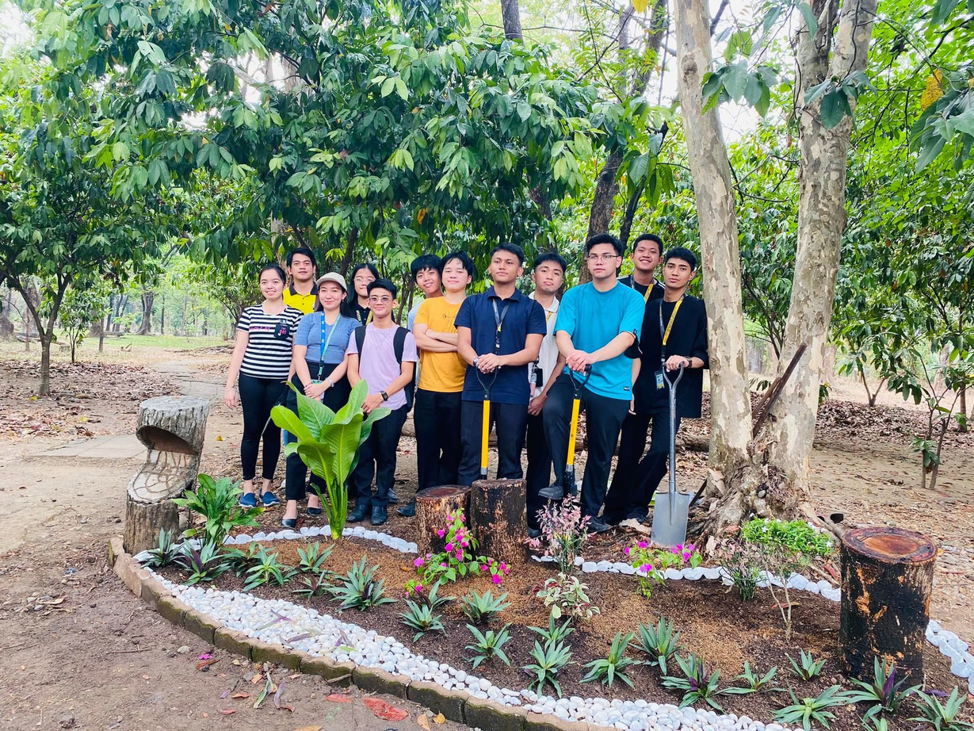
TREE PLANTING
CIVIC WELFARE TRAINING PROGRAM
SAMPLE ONLY
BARANGAY MANGGA
GROUP NAME
DATE CONDUCTED

Slide 2
01
TITLE OF ACTIVITY
02
PROFILE OF BARANGAY/ INSTITUTION
A. Name of Barangay/ Institution
B. Profile of Barangay/ Institution
C. Map
03
SIGNIFICANCE OF THE PROJECT
TABLE OF CONTENTS
04
CWTS OUTREACH PROJECT PROPOSAL
05
REQUEST TO CONDUCT COMMUNITY PROJECT
06
COMMUNITY OUTREACH END ACTIVITY REPORT
07
PICTURES
08
LIQUIDATION REPORT
09
COMMUNITY PROJECT/ ACTIVITY EVALUATION REPORT
A. For Volunteer
10
CERTIFICATE (FROM THE BARANGAY)
11
APPENDICES
A. COMMUNITY PROJECT/ACTIVITY EVALUATION FORM (FOR VOLUNTEERS/PARTICIPANTS)
12
LIST OF MEMBERS

Slide 3
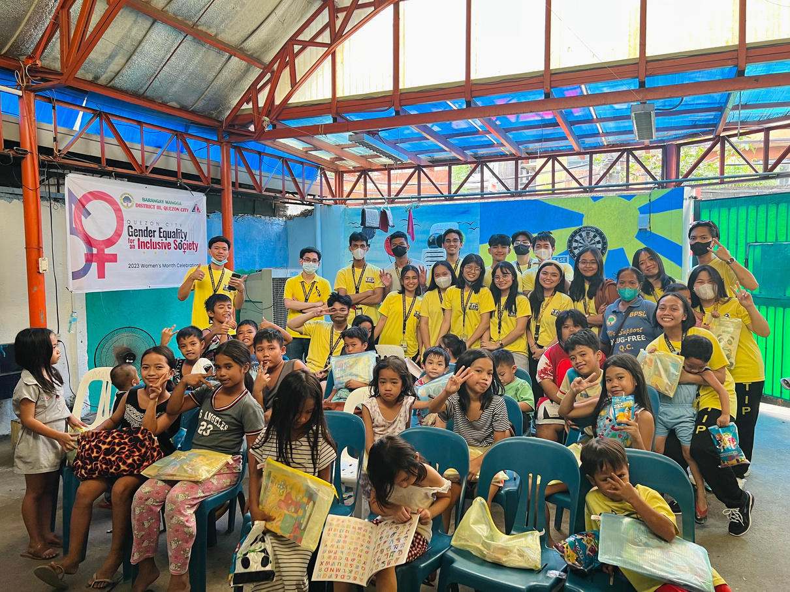
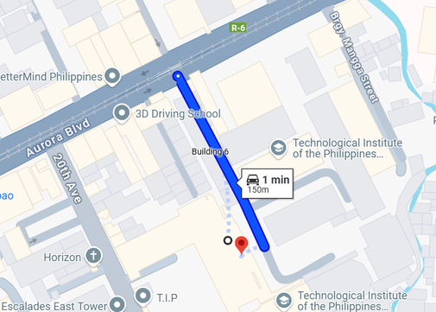
BARANGAY MANGGA
(Sample only)
Profile of the Barangay
Introduction of the Barangay/ Institution including its recent population, area covered, etc.
Map of the Barangay
(Taken from Google map, with caption)

Slide 4


SIGNIFICANCE
OF THE PROJECT
Purpose and Objectives
...........
..........
..........
Impact and Relevance
........
.......
........

Slide 5
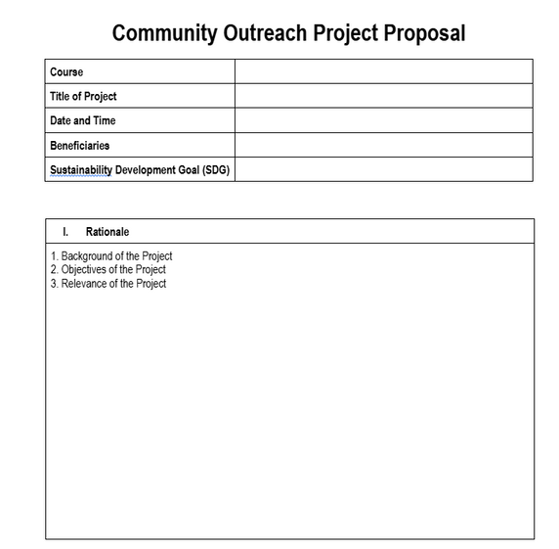
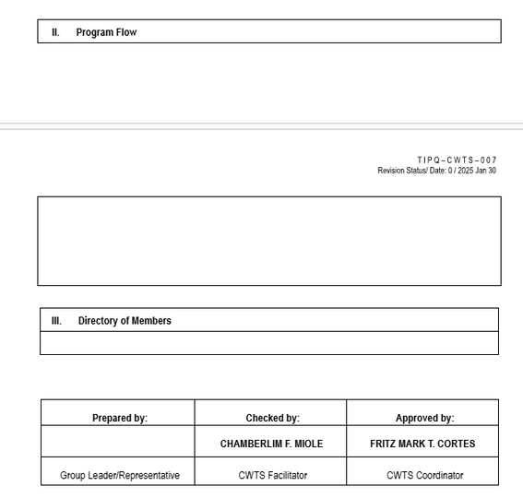

PROJECT PROPOSAL
https://docs.google.com/document/d/1t4YosEoD1D0NzGOJmMietdWc6tCfN0MZ/edit?usp=sharing&ouid=116753439940024903349&rtpof=true&sd=true

Slide 6
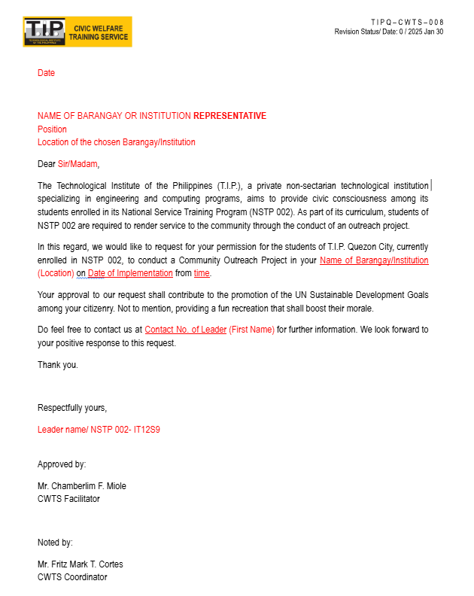
COMMUNICATION
LETTER
https://docs.google.com/document/d/13R0lyMufv5X4XbHUEnBjZJNvcENkLfff/edit?usp=sharing&ouid=116753439940024903349&rtpof=true&sd=true

Slide 7

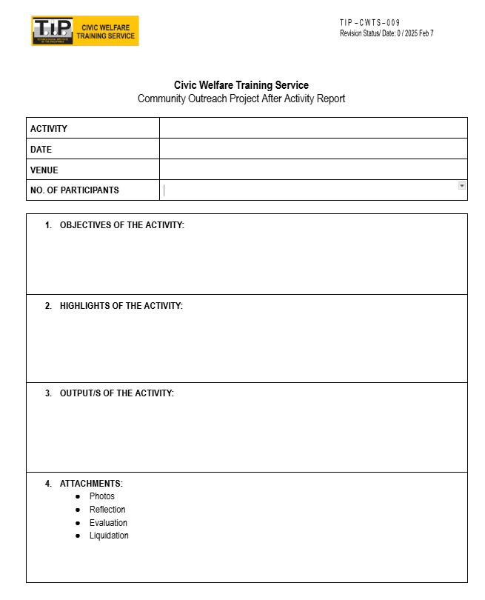
END ACTIVITY
REPORT
https://docs.google.com/document/d/1OiBvhmB7xsdUUWgWm1EXxFadsH_m30F1/edit

Slide 8

(4 TO 10 PICTURES WITH CAPTION, 3R)
(4 TO 10 PICTURES WITH CAPTION, 3R)
(4 TO 10 PICTURES WITH CAPTION, 3R)
PICTURES
(4 TO 10 PICTURES WITH CAPTION, 3R)
(4 TO 10 PICTURES WITH CAPTION, 3R)
(4 TO 10 PICTURES WITH CAPTION, 3R)
(4 TO 10 PICTURES WITH CAPTION, 3R)
(4 TO 10 PICTURES WITH CAPTION, 3R)

Slide 9
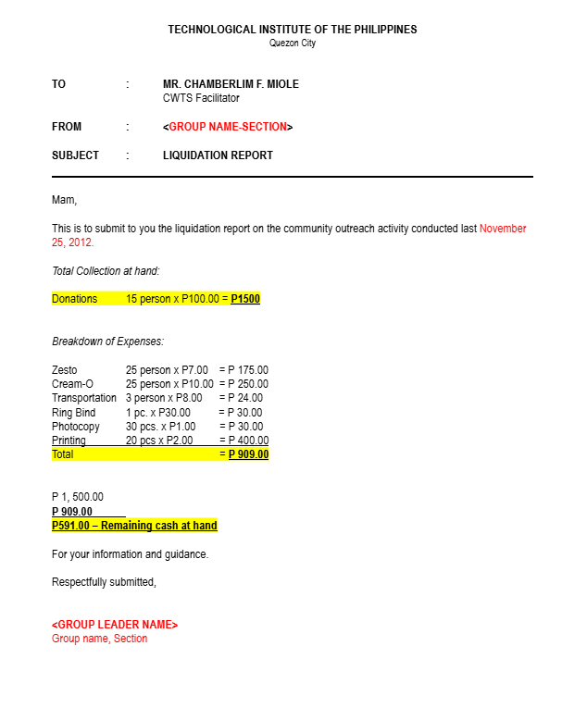
LIQUIDATION
REPORT
https://docs.google.com/document/d/1pcu57scg5Tb5pl69oWdFMUEzk4k_hl6ZorMFFkNK-gk/edit?tab=t.0

Slide 10
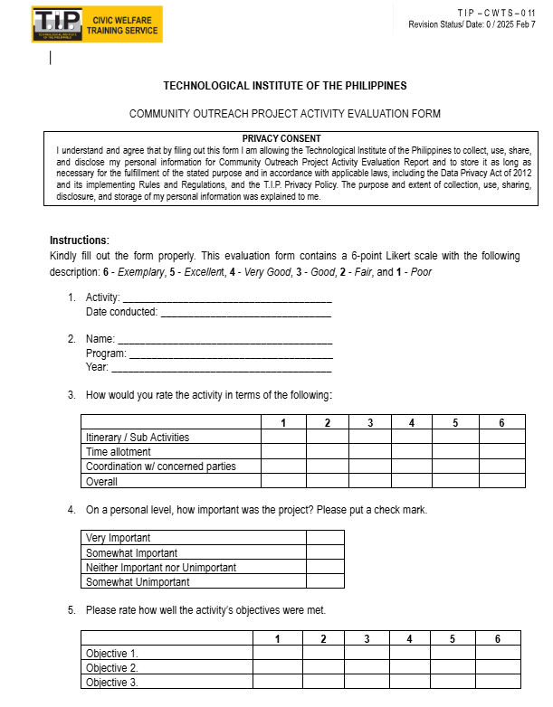
ACTIVITY
EVALUATION REPORT
FOR VOLUNTEER

Slide 11
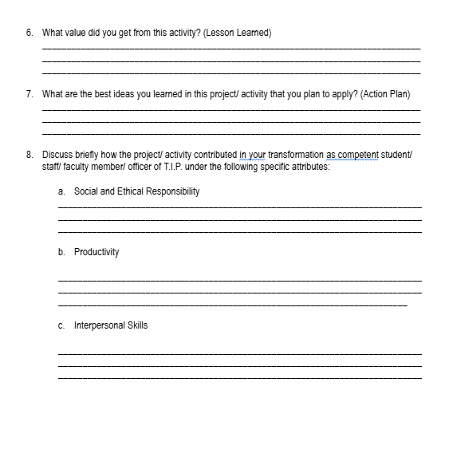
ACTIVITY
EVALUATION REPORT
FOR VOLUNTEER
https://docs.google.com/document/d/1CP160jWghlnB_8p2vwwaNvlpcrt1FT7t/edit

Slide 12
CERTIFICATE

Slide 13

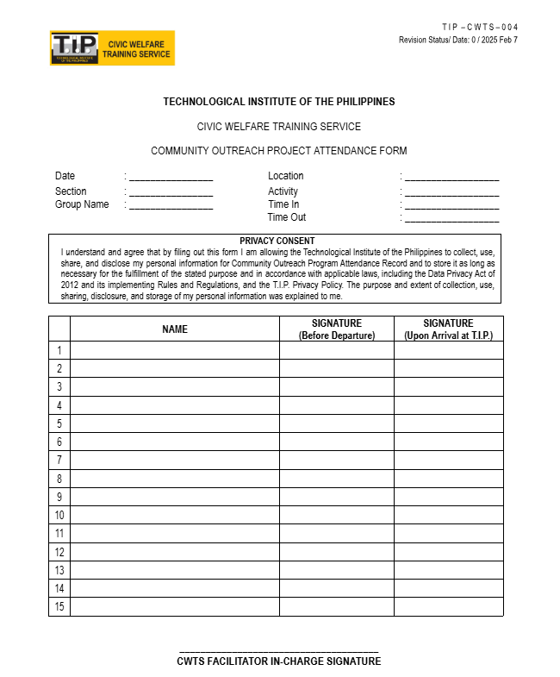
ATTENDANCE
https://docs.google.com/document/d/1rLo1eMv0guBKRkQkDb2TN2uDRatFevwM/edit
MONTH & YEAR

Slide 14
REFLECTION

Slide 15
APPENDICES
Community Project/ Activity Evaluation Form
(For Volunteers/ Participants)

Slide 16

LIST OF MEMBERS

